Slide 1
Grid Design

Slide 2
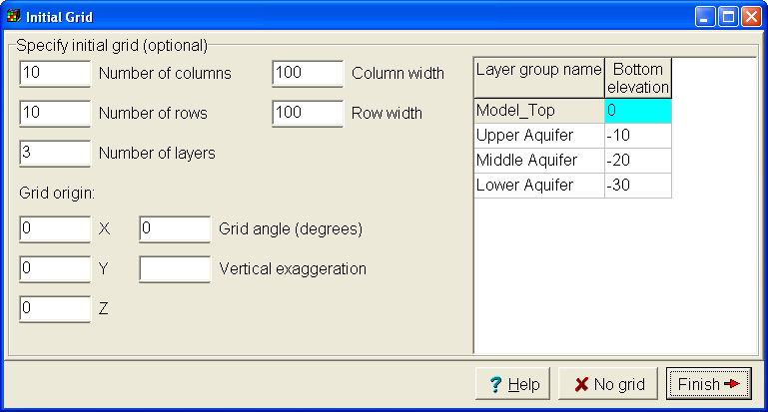
Initial Grid

Slide 3
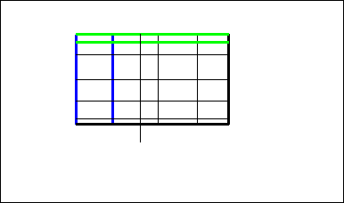
Create a Grid Manually

Slide 4
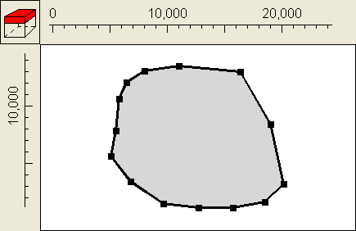
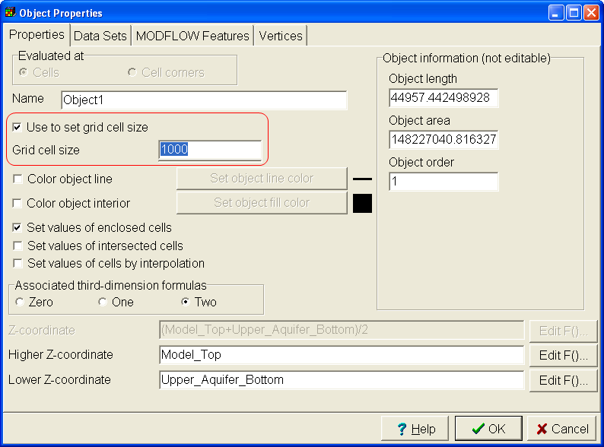
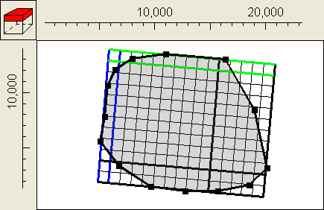
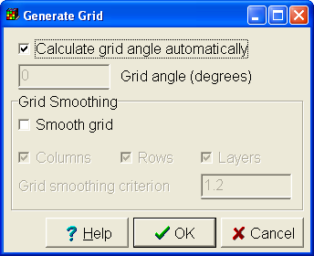
Use Objects to Define Grid

Slide 5
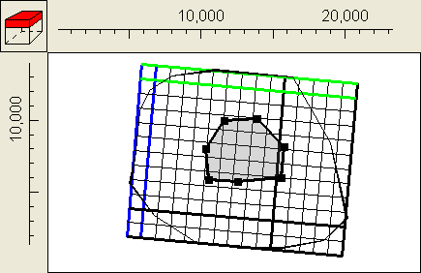
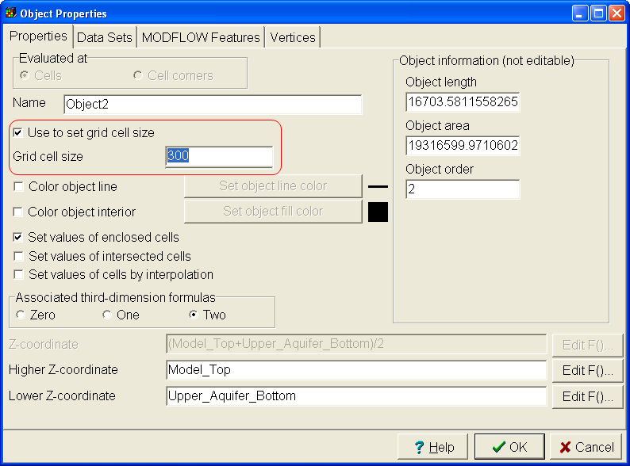
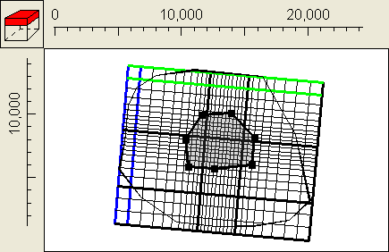
Refine Grid with Objects

Slide 6
Editing the Grid
You can:
Delete grid lines
Move grid lines
Add grid lines
Subdivide grid cells
Specify cell size
Rotate the grid

